Slide 1
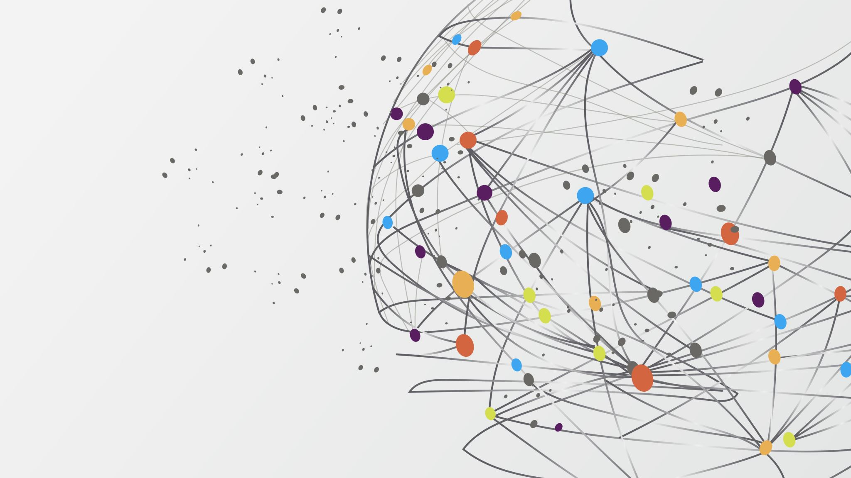
FASHION RECOMENDATION

Slide 2
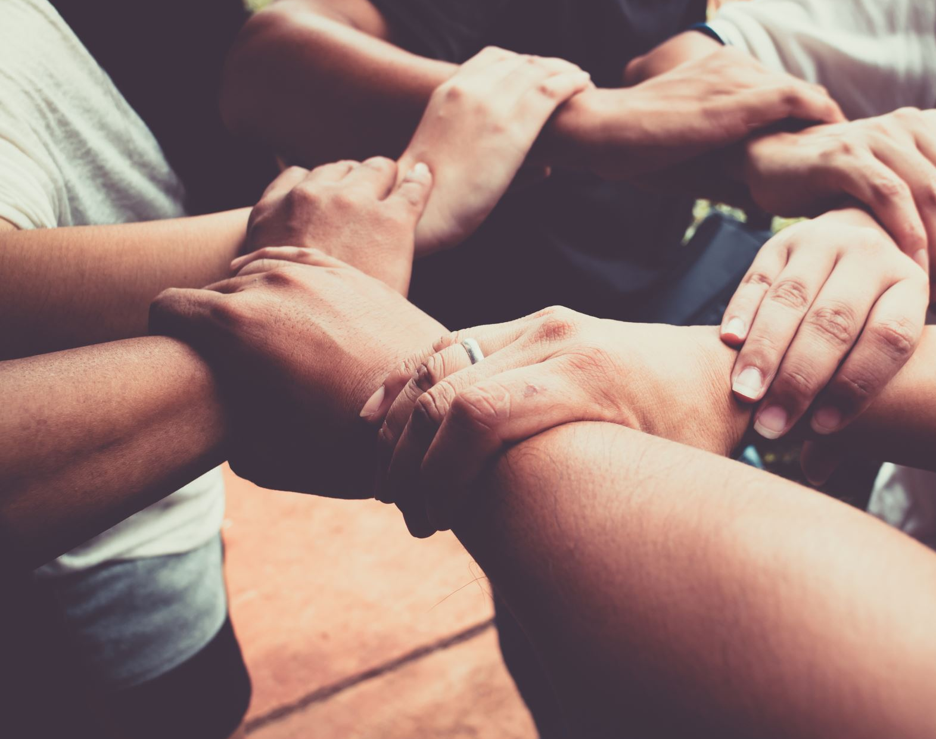
Team Members
Sampath Kumar Garminla
Gowthami Middela
Ajay Kumar Reddy Vemapati

Slide 3
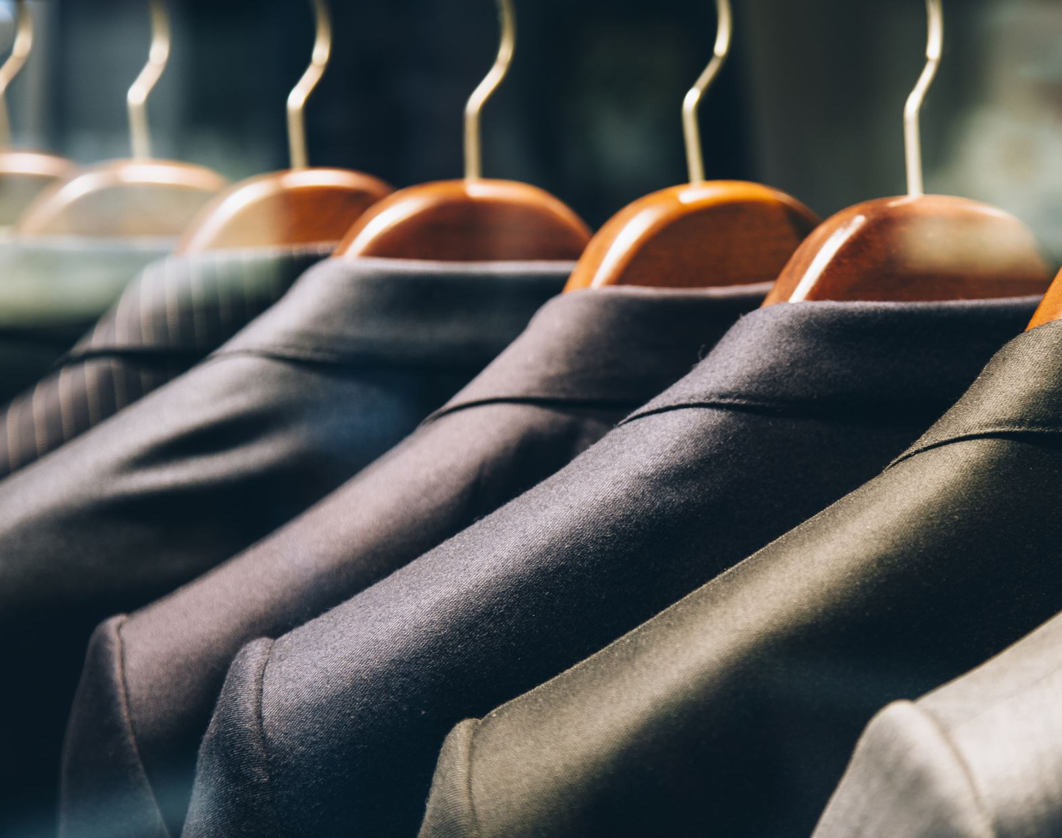
Project Topic
Develop a fashion recommendation system using deep learning to provide personalized fashion recommendations to users based on their preferences and historical data.

Slide 4

Statement of Project Objectives
Develop a deep learning model for fashion recommendation.
Create a database of fashion items with relevant features.
Develop a user interface for collecting user preferences and displaying recommendations.
Evaluate the system's performance and user satisfaction.

Slide 5
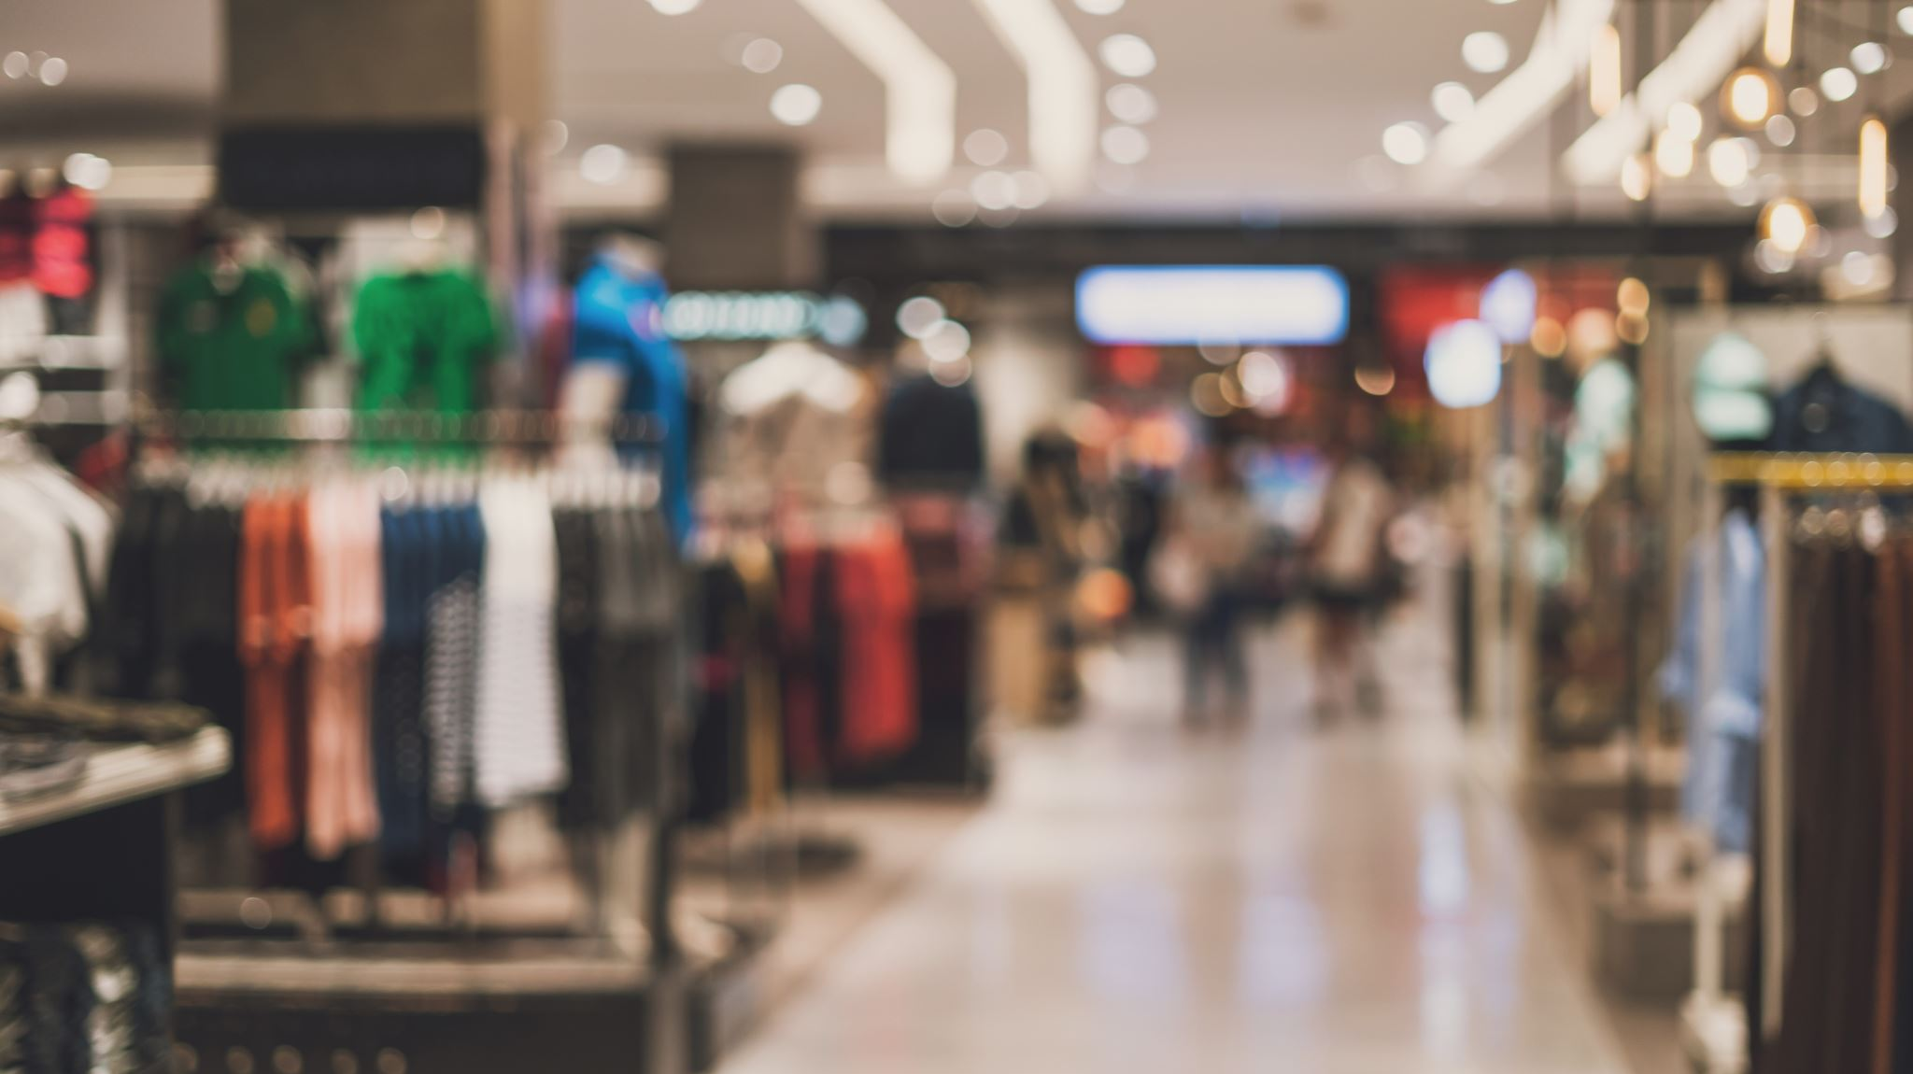
Statement of Value
Provides personalized fashion recommendations, enhancing user experience.
Increases engagement and potential sales for fashion retailers.
Leverages the latest deep learning technologies for accurate recommendations.

Slide 6
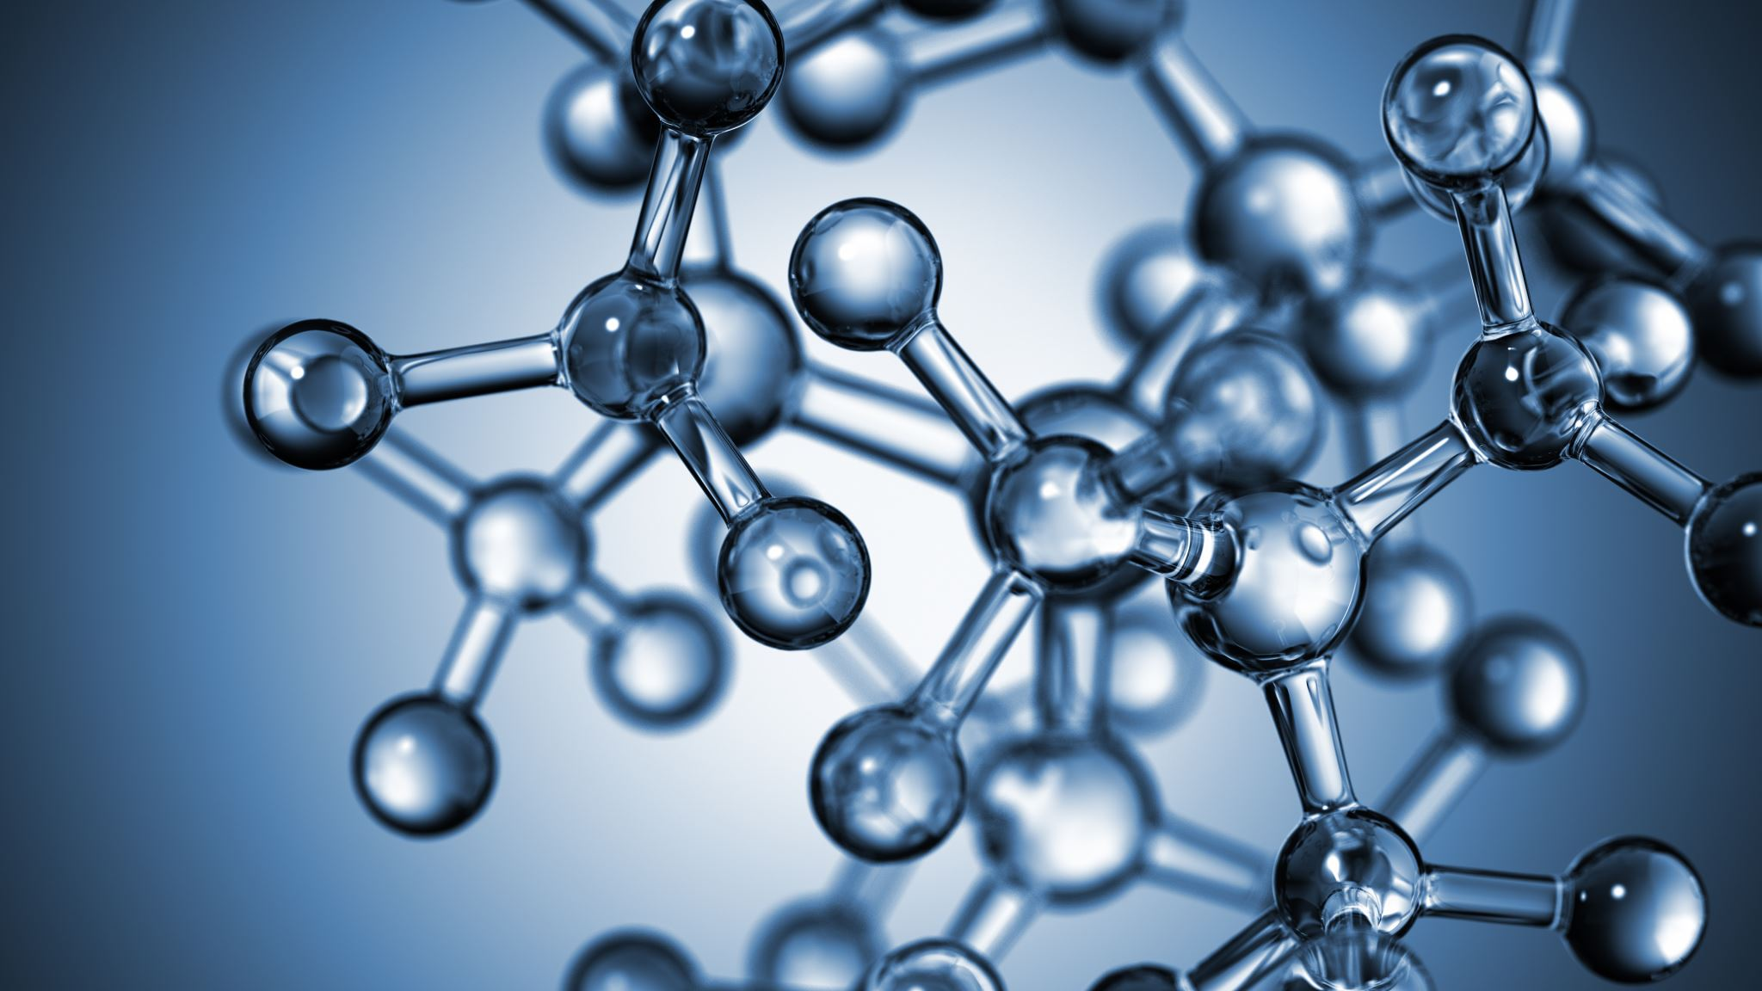
Review of State of the Art and Relevant Works
references 1
The use of bidirectional Long Short-Term Memory networks (LSTMs) to learn fashion compatibility. The authors provide outfit recommendations by utilizing a collection of fashionable ensembles to determine the compatibility of various clothing pie.[1]
references 2
Magic Closet, a customized fashion advice system. The algorithm extracts elements from clothing photographs using visual analysis, mixes these features with fashion expertise, and then generates recommendations for specific outfits.[2]
references 3
A way to use Generative Adversarial Networks (GANs) to generate new fashion designs. The authors train a GAN that can produce new garments that fit a specified style using a dataset of fashion photos.[3]

Slide 7
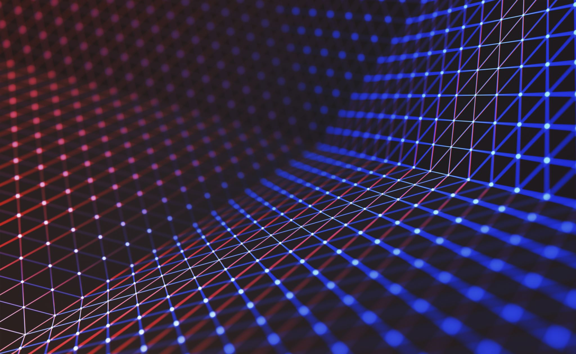
Approach
Algorithms: Deep learning models such as Convolutional Neural Networks (CNNs) for image analysis and recommendation.
Datasets: Images and features of fashion items, user preferences, and historical data.
Models: Pre-trained deep learning models for image analysis.
Tools: Python, TensorFlow, Keras, and other relevant libraries.
Techniques: Image processing, feature extraction, and collaborative filtering.

Slide 8

Deliverables
A working deep learning-based fashion recommendation system.
A database of fashion items with relevant features.
Evaluation and Testing .

Slide 9
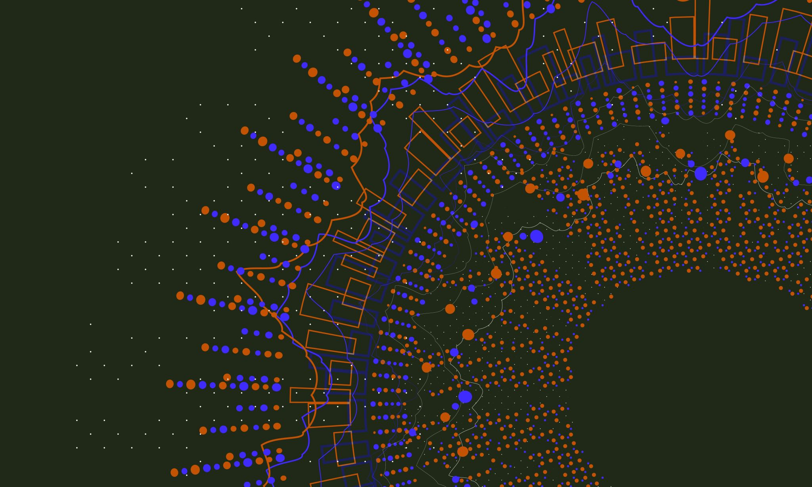
References
Han, Xintong & Wu, Zuxuan & Jiang, Yu-Gang & Davis, Larry. (2017). Learning Fashion Compatibility with Bidirectional LSTMs. 10.1145/3123266.3123394.
Liu, Si & Feng, Jiashi & Song, Zheng & Zhang, Tianzhu & Lu, Hanqing & Xu, Changsheng & Yan, Shuicheng. (2012). Hi, magic closet, tell me what to wear!. 619-628. 10.1145/2393347.2393433.
Jiang, Shuhui & Fu, Yun. (2017). Fashion Style Generator. 3721-3727. 10.24963/ijcai.2017/520.

Slide 10

Thank you

